Slide 1
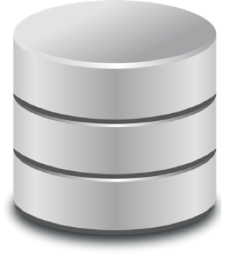
CS186
Introduction to Database Systems
Fall 2016
Amit Shukla
Karthik Ramasamy
@amits
@karthikz

Slide 2
Essential Queries for today
2
Why
What
Who
How
Why should you take this class?
What is this class about?
Who are we?
How will this class work?

Slide 3
Why?
Data is at the center of many things

Slide 4
Why?
Data is at the center of many things
everything

Slide 5
Where should I eat?
5
Where can I get the best Croissants in San Francisco?
“Each ratings star added on a Yelp restaurant review translated to anywhere from a 5 percent to 9 percent effect on revenues”
-- Harvard Business School

Slide 6
How does my Amazon purchase get to me?
6
What route to take?
Order of package delivery?
Is there a dog at that address?
Location to deliver the package
Truck is filled with sensors that record everything
backing up, left turns, gps location, fuel consumed, idle time
Sensors => onboard computer => synced to central database
One minute saved per driver per day adds up to $14.5 million
Notes:
Truck is filled with sensors that record everything: backing up, left turns, gps location, fuel consumed, idle time
Sensors => onboard computer => synced to central database
One minute saved per driver per day adds up to $14.5 million

Slide 7
Making connections?
7
?
Friends
What are they doing?
What have they done?
Love
Finding love through
Data + Algorithms

Slide 8
Creating successful video content
8
Netflix uses data to estimate the potential market size for an original series before green lighting it!
What titles have I watched? Where did I leave off in a given title?
How large a time gap was there between watching one episode and the next?
Recommend new movies based on viewing habits
Infer how much content users need to watch to be less likely to cancel?
Notes:
http://techblog.netflix.com/2015/01/netflixs-viewing-data-how-we-know-where.html
Netflix also used data to target the new series at people who would like similar content.
http://www.nytimes.com/2013/02/25/business/media/for-house-of-cards-using-big-data-to-guarantee-its-popularity.html
http://knowledge.wharton.upenn.edu/article/how-data-analytics-is-shaping-what-you-watch/
http://gigaom.com/2012/06/14/netflix-analyzes-a-lot-of-data-about-your-viewing-habits/
http://gigaom.com/2011/03/18/netflix-big-data/
x.com/2015/01/netflixs-viewing-data-how-we-know-where.html

Slide 9
Berkeley cs186
is not yet involved …

Slide 10
Berkeley cs186
is not yet involved …

Slide 11
Data can help farmers:
predict when to plant and harvest
help them get a fair price
In 2013, a computer model powered by data on crop growth and weather cycles saved $3.8 million dollars on seeds during a drought in Columbia.
Berkeley cs186
is not yet involved …
http://www.data4sdgs.org

Slide 12
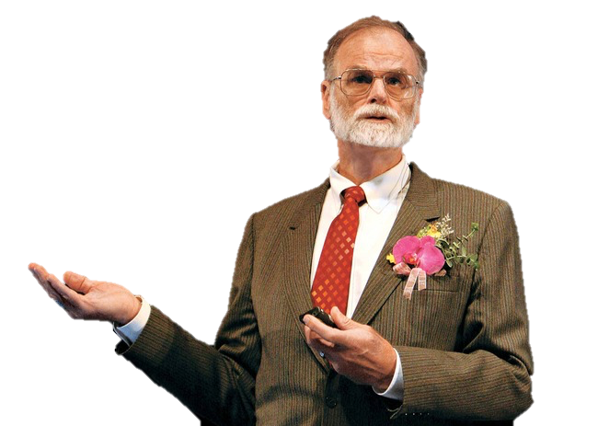
Father of Database Systems
12
Foundations of Transaction Processing
Data Cubes for Analytics
Fault Tolerance
Lost at Sea 2007
Jim Gray
Turing Award Winner
First Berkeley CS PhD
Notes:
Jim Gray did ACID in the 1970s but the term wasn’t formally introduced until 1983 by Andreas Reuter and Theo Harder.
http://www.nytimes.com/2009/12/15/science/15books.html
First Berkeley

Slide 13
… also the Fourth Paradigm
13
Jim Gray
Turing Award Winner
First Berkeley CS PhD
Notes:
http://www.nytimes.com/2009/12/15/science/15books.html

Slide 14
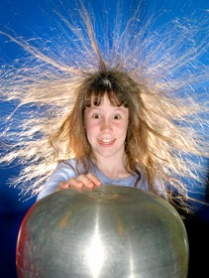
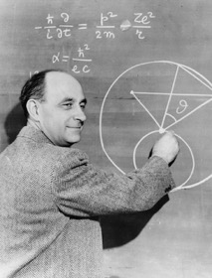
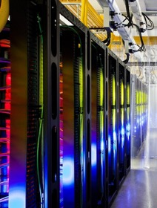

… also the Fourth Paradigm
14
Experimental
Theoretical
Simulation
Data
Intensive
Jim Gray
Turing Award Winner
First Berkeley CS PhD
Notes:
Experimental or empirical – describes natural phenomenon - last few thousand years
Theoretical: last few 100 years; using models and generalizations
Simulate complex phenomenon: 50-70y
Now: Data intensive; unifies experiment, theory and simulations
http://www.nytimes.com/2009/12/15/science/15books.html

Slide 15
Astronomy in the 4th Paradigm
15
+
Sloan Digital
Sky Survey (SDSS)
Sky Server
Database
Systems
Notes:
Jim Gray did ACID in the 1970s but the term wasn’t formally introduced until 1983 by Andreas Reuter and Theo Harder.
http://www.nytimes.com/2009/12/15/science/15books.html
1.6PB dataset (80GB DB), huge at the time; 20 second or less response time
20 queries, 12 data visualizations

Slide 16
Astronomy in the 4th Paradigm
16
Notes:
Jim Gray did ACID in the 1970s but the term wasn’t formally introduced until 1983 by Andreas Reuter and Theo Harder.
http://www.nytimes.com/2009/12/15/science/15books.html
First Berkeley

Slide 17
Data is Growing
17

Slide 18
18
https://www.domo.com/blog/2016/06/data-never-sleeps-4-0/
Notes:
How much data is generate/used every minute?

Slide 19
19
https://www.domo.com/blog/2016/06/data-never-sleeps-4-0/
Notes:
How much data is generate/used every minute?

Slide 20
20
https://www.domo.com/blog/2016/06/data-never-sleeps-4-0/
Notes:
How much data is generate/used every minute?

Slide 21
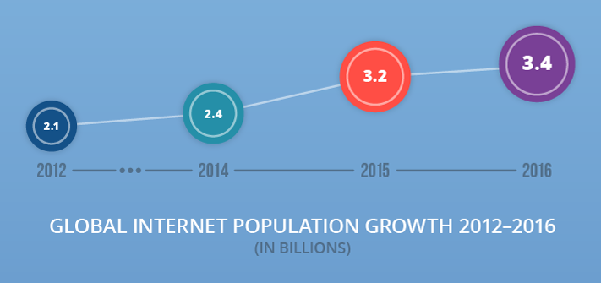
21
https://www.domo.com/blog/2016/06/data-never-sleeps-4-0/
Notes:
How much data is generate/used every minute?

Slide 22
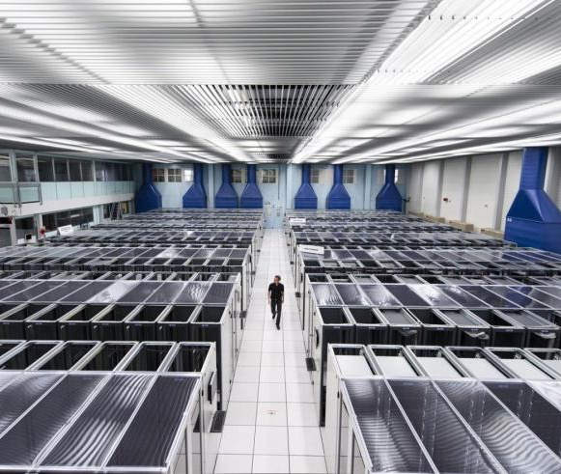
Scale of Scientific Data
22
Large Hadron Collider (LHC)
150M Sensors @ 40M times per second: 6 Peta-events per second
Massive filtering (data loss) → 700 MB per second → 15 PB per year
Data collection is limited by compute and storage
Notes:
https://lhcb-public.web.cern.ch/lhcb-public/en/Data%20Collection/Triggers2-en.html
http://home.cern/about/computing
http://cds.cern.ch/record/1165534/files/CERN-Brochure-2009-003-Eng.pdf

Slide 23
Forces Driving Data Growth
23
Machine generated data
Ubiquitous sensors and reporting: Cameras, mobile computing, …
Large collaborative science projects
Philosophy: Save all data → figure out how to derive value from it
Enabling technology: Cheap, Scalable data management systems

Slide 24
What: Summing up
24
Data is at the center of many things everything
For instance: Computer Science

Slide 25
Data is at the center of CS
25
You may think: in CS186 we learn to apply computer science to Big Data.
No
The techniques we will learn are the key to scalable computer science
This class applies very broadly

Slide 27
A Syllogism of Quotes
27
“Information is knowledge” – Albert Einstein
“knowledge is power” – Sir Francis Bacon
“with great power comes great responsibility” – Uncle Ben (Spiderman)

Slide 28

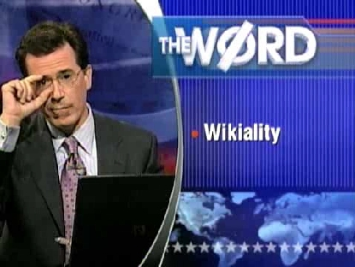
Data Integrity: Not all Data is Correct
28
“Any user can change any entry, and if enough users agree with them, it becomes true” – Stephen Colbert
Asked users to update the page on Elephants to reflect a tripling of population, forcing Wikipedia to lock the page!
2005 Nature study found Wikipedia science articles to be similar in accuracy to Encyclopedia Britannica.
Notes:
Colbert show link: https://www.youtube.com/watch?v=20PlHx_JjEo
"together we can create a reality that we all agree on—the reality we just agreed on."

Slide 29
The “Right?” to privacy
29
Notes:
Numbers from the guardian
Xkeyscore is latest system (built on federated MySQL servers) replaced Marianas
Warren Brandeis “The Right to Privacy” -- "right to be let alone”
December 15, 1890 issue of the Harvard Law Review, written by attorney Samuel D. Warren and future U.S. Supreme Court Justice Louis Brandeis, entitled The Right To Privacy, is often cited as the first implicit declaration of a U.S. right to privacy. Warren and Brandeis wrote that privacy is the "right to be let alone", and focused on protecting individuals. This approach was a response to recent technological developments of the time, such as photography, and sensationalist journalism, also known as "yellow journalism".[3]
fourth amendment to the US constitution, which states that 'The right of the people to be secure in their persons, houses, papers, and effects,^{[a]} against unreasonable searches and seizures, shall not be violated, and no Warrants shall issue, but upon probable cause, supported by Oath or affirmation, and particularly describing the place to be searched, and the persons or things to be seized.^{[19]}'.

Slide 30
The Power of Facebook Likes
30
Using Facebook like data for 58k users, a Cambridge team was able to predict:
Male sexuality: 88% accuracy
Black vs White: 95% accuracy
Rep. vs Dem.: 85% accuracy
Christian vs Muslim: 82% accuracy
Required deep inference into the content of posts
http://www.pnas.org/content/110/15/5802.full.pdf
Notes:
http://www.cam.ac.uk/research/news/digital-records-could-expose-intimate-details-and-personality-traits-of-millions

Slide 31
So… Why?
31
Data is at the center of everything
People who know how to store, manage and use data will be at the center of the future
Great Power → Great Responsibility
You can be a part of the changing world of data systems

Slide 32
Essential Queries for today
32
Why
What
Who
How
Why should you take this class?
What is this class about?
Who are we?
How will this class work?

Slide 33
What is this class about?
33
Databases?

Slide 34
What is a Database?

Slide 35
Universal Symbol for a Database
35
Notes:
http://stackoverflow.com/questions/2822650/why-is-a-database-always-represented-with-a-cylinder
https://en.wikipedia.org/wiki/Drum_memory

Slide 36
Why the symbol?
36
Platters on a Disk Drive
Looks Like?

Slide 37
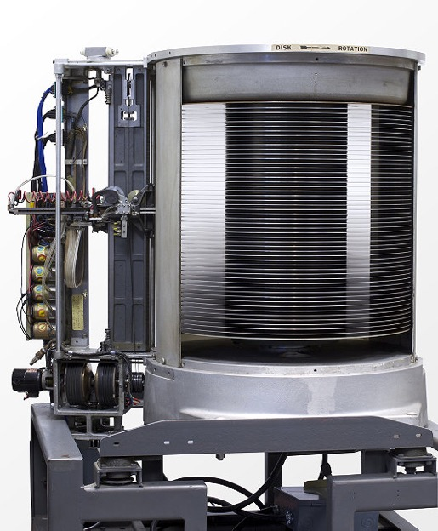
Why the symbol?
37
Looks Like
“...We must immediately...attack accounting problems under the philosophy of handling each business transaction as it occurs, rather than under the present condition of batching techniques....”
-- F. J. Wesley IBM Senior Manager
1956: IBM MODEL 350 RAMAC
First Commercial Disk Drive
5MB @ 1 ton
http://www.computerhistory.org/storageengine/first-commercial-hard-disk-drive-shipped
Notes:
RAMAC (Random Access Method of Accounting and Control)
50 x 24-inch diameter disks
rotated at 1200 rpm
stored 5 million, 6-bit characters at an areal density of 2,000 bits/sq.
1 second seek latency
5ft high by 6ft wide
1 ton
And $750 a month to lease

Slide 38
Is this a database?
38
Rolodex contains Contacts
Organized alphabetically
≈
Notes:
Have you ever used one?

Slide 39
Is this a database?
39
Facebook contains
Contacts
Events
Posts
Organized …
Facebook
Collection of DBs and “business logic”

Slide 40
Is this a database?
40
Flight Booking:
Early application of of database systems
Expedia
Collection of DBs and “business logic”

Slide 41
What is a Database?
41
A Database is a large, organized collection of data
A Database Management System (DBMS) is software that stores, manages and facilitates access to databases

Slide 42
Relational Database Management Systems
42
Traditionally DBMS referred to Relational Databases
RDBMS is a more appropriate term
SQL data description and manipulation language
ACID transaction consistency
Durable writes (to prevent data loss)
Mature technologies …

Slide 43
Ranking of DBMS Technologies
43
DB Engines Ranking
Based on #mentions (e.g., stack overflow), google trends, job postings, profile data on LinkedIn, tweets …
Notes:
http://db-engines.com/en/ranking

Slide 44
Relational Database Market
44
Big Market > 45B
Notes:
http://www.infoworld.com/article/2916057/open-source-software/open-source-threatens-to-eat-the-database-market.html

Slide 45
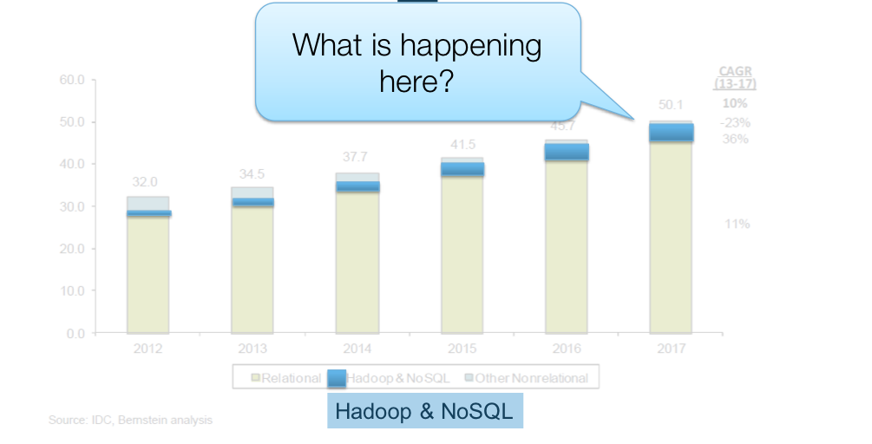
Relational Database Market
45
Notes:
http://www.infoworld.com/article/2916057/open-source-software/open-source-threatens-to-eat-the-database-market.html

Slide 46
Relational Database Market
46
Over 200 Platforms
Notes:
Note that 451 Research Group is biased towards new and emerging technologies.

Slide 47
Relational Database Market
47
Notes:
Note that 451 Research Group is biased towards new and emerging technologies.

Slide 48
DBMS Technology is Changing
48
Key drivers of change
Hardware trends: cheap RAM & SSDs
Need to scale: storage and transactions
New data-types: text, json, …
New workloads: machine learning & analytics
New DBMS technologies are emerging:
NoSQL: abandon relational model, gain scale
Map-Reduce: distributed batch analytics
…

Slide 49
Problems & Opportunities
49
The DMBS world is rapidly changing
Opportunity: You can shape the future of DBMS…
Problem: Textbook is a little out-of-date (2003)
We are going to use the Textbook for foundational principles
Reusable Ideas and Components
Compositional Approach
Augment with advances since then
E.g.: Cloud Data warehousing
You will be able to use existing & build new DBMS technologies!

Slide 50
You will learn …
50
Data Oriented Programming with SQL
Foundations of Data System Design
Storage, indexing, and query processing
Transactions
Concurrency, Consistency, and Recovery

Slide 51
Principles
51
Data independence (logical vs physical)
Declarative programming
Locality in space and time
Isolation and consistency
Tables, views, and queries

Slide 52
Systems
52
Examine various levels of a database system
Query Optimization and Execution
Distributed
Execution
Relational Operators
File and Access Methods
Concurrency Control and Recovery
Buffer Management
Disk Space Management

Slide 53
Current topics
53
Parallel databases
Data Warehousing
Hadoop and Spark
NoSQL
Streaming computation

Slide 54
Summary
54
What is this class about?
Databases → Database Management Systems
Big Ideas in DBMS
Principles
Systems Design
Current topics

Slide 55
Essential Queries for today
55
Why
What
Who
How
Why should you take this class?
What is this class about?
Who are we?
How will this class work?

Slide 56
About Me: Amit Shukla
56
Director of Engineering @ Docker
First class with 400+ students
PhD from Wisconsin
Work:
Data management at Scale: Microsoft SQL, Twitter
Distributed systems
Other interests:
Hiking, Running, Snowboarding, Travel

Slide 57
About Me: Karthik Ramasamy
57
Streaming compute @ Twitter
Also first class with 400+ students
PhD from Wisconsin
Work:
Stream processing before it was hot
Startup guy
Network routing textbook
Other interests:
Photography, Hiking, Road trips

Slide 58
TAs
09
Amruta Yelamanchili
Anurag Baddam
Larry Xu
Sammy Sidhu
Selena Shang
Warren Shen
Vikram Sreekanti
(lead TA)

Slide 59
About You! And your career …
59
2000’s:
Shift from “programs” to data-centric services
More recently:
End of the full-stack programmer
New, ubiquitous professions:
Data Scientist
Data Engineer
Evolution of IT
Two things to acknowledge:
Fundamentals of this class are key
Things will change

Slide 60
Essential Queries for today
60
Why
What
Who
How
Why should you take this class?
What is this class about?
Who are we?
How will this class work?

Slide 61
How? Administrivia
61
http://www.cs186berkeley.net
Web calendar for sections, Office hours
Slides and videos available after lecture

Slide 62
How? Administrivia, contd…
62
Textbook
Database Management Systems, 3rd Edition
Ramakrishnan and Gehrke
Suggested
I wouldn’t buy any more textbooks
Website/HWs will have links to programming resources
Grading, hand-in policies, etc.: on Web Page
Cheating policy: zero tolerance
We have the technology…

Slide 63
How? Administrivia, contd…
63
All class communication via Piazza
https://piazza.com/class/is0phopc27275j announcements and discussion
read it regularly
post all questions/comments there
direct email is not a good idea

Slide 64
How? Homework
64
8 homework assignments (0-7)
Graded on completion
HW0: Assigned today, due this Monday 8/29
HW1: assigned on Monday 8/29, Due 9/7
Details coming on Piazza
CS186 github repo on class website

Slide 65
How? Homework contd…
65
Homework with real world focus:
SQL Programming
Files and indexes
Sorting & hashing
Joins and query optimization
Transactions and Recovery
ER modelling, FDs, Parallel DBs
Spark Notebooks

Slide 66
How? Projects & Exams
66
3 projects – significant time commitment!
Individual
2 mid-terms (October 5, Nov 7)
1 final exam

Slide 67
How? Grading policy
67
Project: 45% of semester grade (15% per project).
Homework: 10% of semester grade.
Two Mid-terms: 20% of the semester grade total.
12% will come from your higher-scored exam,
8% from your lower-scored exam.
Final Exam: 25% of the semester grade.

Slide 68
Essential Queries for today
68
Why
What
Who
How
Why should you take this class?
What is this class about?
Who are we?
How will this class work?
SELECT * FROM cs186_ideas LIMIT 1

Slide 69
Dealing with Big Data
69
1. Read something
2. Do something
3. Write something
4. GOTO 1
CPU
The Von Neumann machine: Ordered reasoning over data

Slide 70
Dealing with Big Data
70
1. Read something
2. Do something
3. Write something
4. GOTO 1
CPU
“Out-of-Core” algorithms.

Slide 71
Dealing with Big Data
71
CPU
CPU
CPU
CPU
CPU
CPU
CPU
CPU
CPU
Scaling up

Slide 72

Dealing with Big Data
72
CPU
CPU
CPU
CPU
CPU
CPU
CPU
CPU
CPU
Distributed Computing and Parallelism

Slide 73
Basic Patterns for Big Data
73
Streaming
Divide-and-Conquer

Slide 74
Simplifying Assumption
74
Corollary: can reorder handling of items!
The opposite of Von Neumann
Disorderly reasoning over disorderly data
Unordered collections of data items.

Slide 75
Disorder is a friend of Scaling
75
We can order things to our liking
For cache locality, rendezvous, etc.
We can work on things in batches
Pick batch sizes to fit our memory hierarchy
Pick batch contents based on data affinities
OK to postpone data that doesn’t fit nicely in the current batch
We can tolerate non-deterministic orders
E.g. the result of parallel execution
For efficiency

Slide 76
Streaming through RAM
76
Simple case: “Map”.
Goal: Compute f(x) for each record, write out the result
Challenge: minimize RAM, call read/write rarely
INPUT
OUTPUT
RAM

Slide 77
Streaming through RAM
77
Simple case: “Map”.
Goal: Compute f(x) for each record, write out the result
Challenge: minimize RAM, call read/write rarely
Approach
Read a sizable chunk from INPUT to an Input Buffer
Write f(x) for each item to an Output Buffer
When Input Buffer is consumed, read another chunk
When Output Buffer fills, write it to OUTPUT
Reads and Writes are not coordinated
E.g., if f() is Compress(), you read many chunks per write.
E.g., if f() is DeCompress(), you write many chunks per read.
Input
Buffer
Output
Buffer
INPUT
f(x)
OUTPUT
RAM

Slide 78
Parallelize Me
78
Input
Buffer
Output
Buffer
INPUT
f(x)
OUTPUT
RAM

Slide 79
Parallelize Me
79
Input
Buffer
Output
Buffer
INPUT
f(x)
OUTPUT
RAM
Input
Buffer
Output
Buffer
INPUT
f(x)
OUTPUT
RAM
Input
Buffer
Output
Buffer
INPUT
f(x)
OUTPUT
RAM

Slide 80
Unix Pipes
80
STDIN and STDOUT streams
streaming UNIX utilities get/put lines
Connect them up with |
OS will do chunking for you
e.g. “find students who got 100 on one assignment, and got 0 on no assignments”
% sed 1d grades.csv | grep ',100'| grep -v ',0' | cut -f 1 -d ','

Slide 81
Rendezvous
81
Streaming: one chunk at a time. Easy.
But some algorithms need certain items to be co-resident in memory
not guaranteed to appear in the same input chunk
Time-space Rendezvous
in the same place (RAM) at the same time
most of computing (and life?) is about this
There may be many combos of such items

Slide 82
Divide and Conquer
82
Out-of-core algorithms orchestrate rendezvous.
Typical RAM Allocation:
Assume B chunks worth of RAM available
Use 1 chunk of RAM to read into
Use 1 chunk of RAM to write into
B – 2 chunks of RAM left as space for rendezvous
B
DISK 2
DISK 1
INPUT
OUTPUT
IN
OUT

Slide 83
Divide and Conquer
83
Phase 1
“streamwise” divide into N/(B-2) megachunks
conquer each and write to disk
B-2 chunks in each
B
DISK 2
DISK 1
N
INPUT
OUTPUT
OUTPUT
IN
OUT

Slide 84
Divide and Conquer
84
Phase 2
a streaming algorithm over conquered megachunks.
the streaming must ensure rendezvous
but across rendezvous groups, order still immaterial!
We will see concrete examples shortly
B-2 chunks in each
B
DISK 2
DISK 1
N
INPUT
OUTPUT
OUTPUT
IN
OUT

Slide 85

Parallelize Me?
85
Phase 1
B
IN
OUT
B
IN
OUT
B
IN
OUT

Slide 86
Parallelize Me?
86
Phase 1+: partition data, communicate for rendezvous in space!
B
B
IN
OUT
IN
OUT
B
B
IN
OUT
IN
OUT
B
B
IN
OUT
IN
OUT

Slide 87
Summing Up 1
87
Unordered collection model
Read in chunks to reduce I/O overhead
Two main techniques
Streaming
Divide & Conquer for rendezvous
Parallelism falls out fairly naturally

Slide 88
Summing Up 2
88
Pure streaming is fast and low-memory
one-pass
chunking minimizes I/O fixed costs
Try to avoid ordering requirements

Slide 89
Next: starting with the Fundamentals
89
Those who cannot remember the past are condemned to repeat it.
-- George Santayana
If I have seen further than others, it is by standing upon the shoulders of giants
-- Isaac Newton
It’s deja vu all over again
-- Yogi Berra

Slide 90
Life of a Query
90
Declarative Query (SQL)
Running example throughout the class
Query Optimization and Execution
(Relational) Operators
File and Access Methods
Buffer Management
Disk Space Management

Slide 91
Up Next
91
Declarative Query (SQL)

